Slide 1
Processes and Threads
Chapter 2
Tanenbaum & Bo,Modern Operating Systems:4th ed., (c) 2013 Prentice-Hall, Inc. All rights reserved.

Slide 2
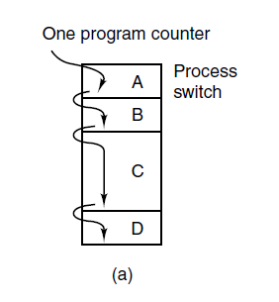
The Process Model (1)
Figure 2-1. (a) Multiprogramming of four programs.
Tanenbaum & Bo,Modern Operating Systems:4th ed., (c) 2013 Prentice-Hall, Inc. All rights reserved.

Slide 3
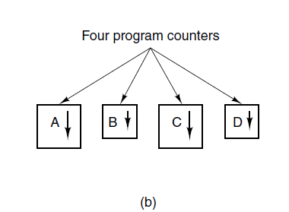
The Process Model (2)
Figure 2-1. (b) Conceptual model of
four independent, sequential processes.
Tanenbaum & Bo,Modern Operating Systems:4th ed., (c) 2013 Prentice-Hall, Inc. All rights reserved.

Slide 4
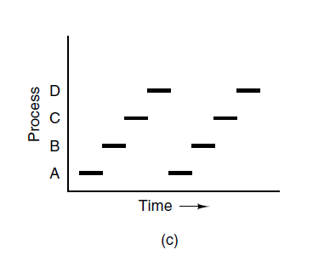
The Process Model (3)
Figure 2-1. (c) Only one program is active at once.
Tanenbaum & Bo,Modern Operating Systems:4th ed., (c) 2013 Prentice-Hall, Inc. All rights reserved.

Slide 5
Process Creation
Four principal events that cause processes to be created:
System initialization.
Execution of a process creation system call by a running process.
A user request to create a new process.
Initiation of a batch job.
Tanenbaum & Bo,Modern Operating Systems:4th ed., (c) 2013 Prentice-Hall, Inc. All rights reserved.

Slide 6
Process Termination
Typical conditions which terminate a process:
Normal exit (voluntary).
Error exit (voluntary).
Fatal error (involuntary).
Killed by another process (involuntary).
Tanenbaum & Bo,Modern Operating Systems:4th ed., (c) 2013 Prentice-Hall, Inc. All rights reserved.

Slide 7
Process States (1)
Three states a process may be in:
Running (actually using the CPU at that instant).
Ready (runnable; temporarily stopped to let another process run).
Blocked (unable to run until some external event happens).
Tanenbaum & Bo,Modern Operating Systems:4th ed., (c) 2013 Prentice-Hall, Inc. All rights reserved.

Slide 8
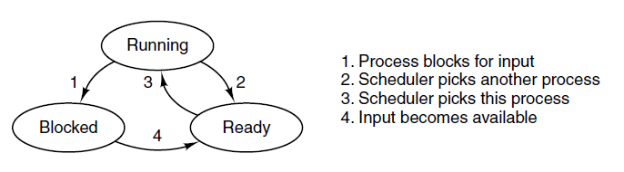
Process States (2)
Figure 2-2. A process can be in running, blocked, or ready state. Transitions between these states are as shown.
Tanenbaum & Bo,Modern Operating Systems:4th ed., (c) 2013 Prentice-Hall, Inc. All rights reserved.

Slide 9
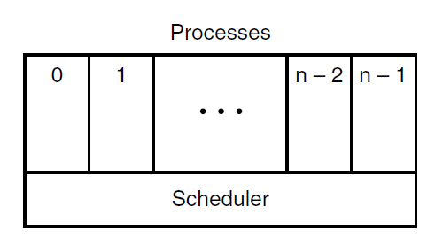
Process States (3)
Figure 2-3. The lowest layer of a process-structured operating system handles interrupts and scheduling. Above that layer are sequential processes.
Tanenbaum & Bo,Modern Operating Systems:4th ed., (c) 2013 Prentice-Hall, Inc. All rights reserved.

Slide 10
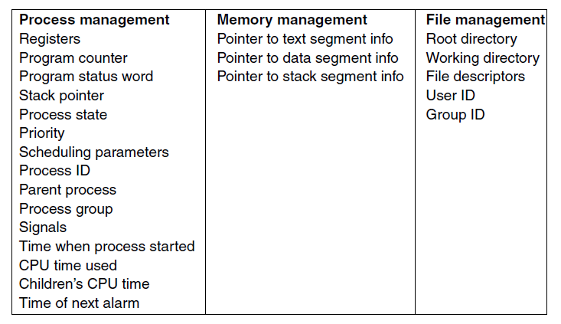
Implementation of Processes (1)
Figure 2-4. Some of the fields of a typical process table entry.
Tanenbaum & Bo,Modern Operating Systems:4th ed., (c) 2013 Prentice-Hall, Inc. All rights reserved.

Slide 11
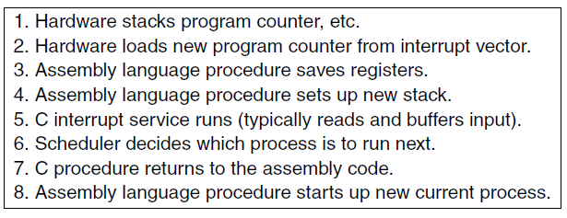
Implementation of Processes (2)
Figure 2-5. Skeleton of what the lowest level of the operating system does when an interrupt occurs.
Tanenbaum & Bo,Modern Operating Systems:4th ed., (c) 2013 Prentice-Hall, Inc. All rights reserved.

Slide 12
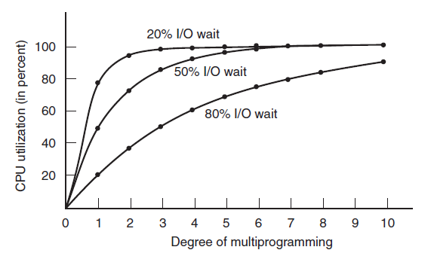

Modeling Multiprogramming
Figure 2-6. CPU utilization as a function of the number of processes in memory.
Tanenbaum & Bo,Modern Operating Systems:4th ed., (c) 2013 Prentice-Hall, Inc. All rights reserved.

Slide 13
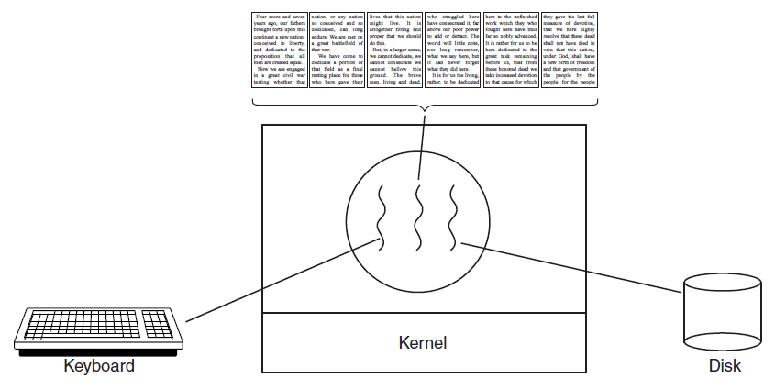
Thread Usage (1)
Figure 2-7. A word processor with three threads.
Tanenbaum & Bo,Modern Operating Systems:4th ed., (c) 2013 Prentice-Hall, Inc. All rights reserved.

Slide 14
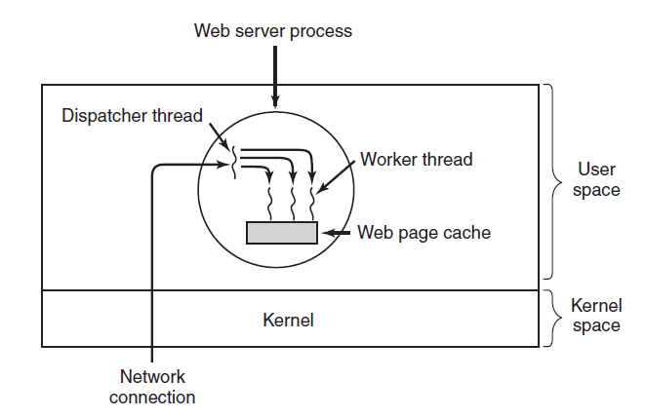
Thread Usage (2)
Figure 2-8. A multithreaded Web server.
Tanenbaum & Bo,Modern Operating Systems:4th ed., (c) 2013 Prentice-Hall, Inc. All rights reserved.

Slide 15
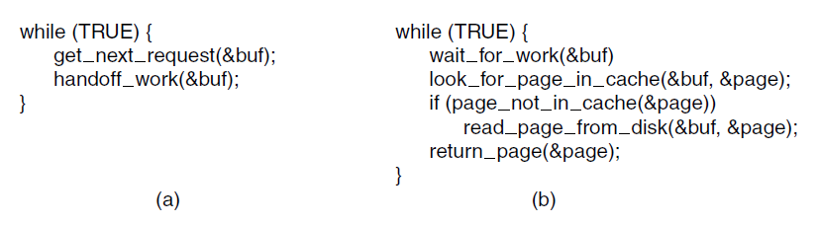
Thread Usage (3)
Figure 2-9. A rough outline of the code for Fig. 2-8.
(a) Dispatcher thread. (b) Worker thread.
Tanenbaum & Bo,Modern Operating Systems:4th ed., (c) 2013 Prentice-Hall, Inc. All rights reserved.

Slide 16
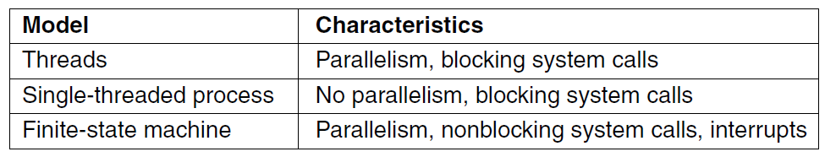
Thread Usage (4)
Figure 2-10. Three ways to construct a server.
Tanenbaum & Bo,Modern Operating Systems:4th ed., (c) 2013 Prentice-Hall, Inc. All rights reserved.

Slide 17
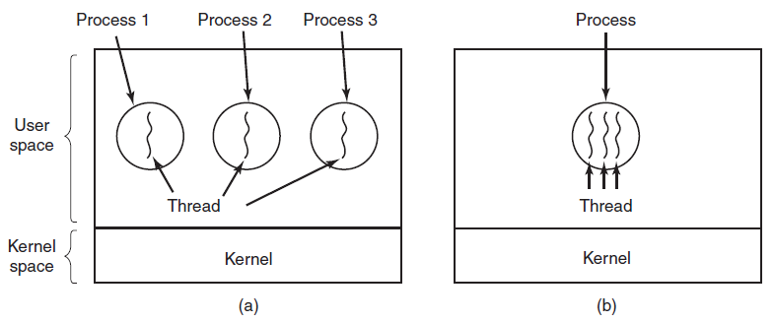
The Classical Thread Model (1)
Figure 2-11. (a) Three processes each with one thread.
(b) One process with three threads.
Tanenbaum & Bo,Modern Operating Systems:4th ed., (c) 2013 Prentice-Hall, Inc. All rights reserved.

Slide 18
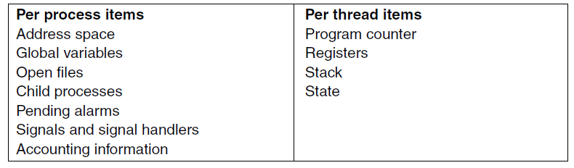
The Classical Thread Model (2)
Figure 2-12. The first column lists some items shared by all threads in a process. The second one lists some items private to each thread.
Tanenbaum & Bo,Modern Operating Systems:4th ed., (c) 2013 Prentice-Hall, Inc. All rights reserved.

Slide 19
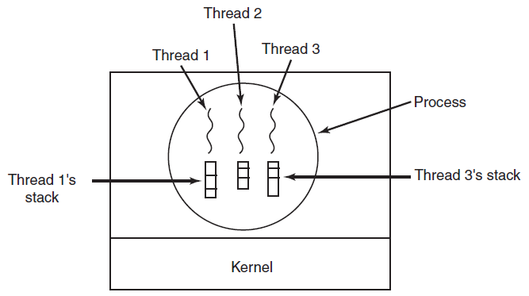
The Classical Thread Model (3)
Figure 2-13. Each thread has its own stack.
Tanenbaum & Bo,Modern Operating Systems:4th ed., (c) 2013 Prentice-Hall, Inc. All rights reserved.

Slide 20
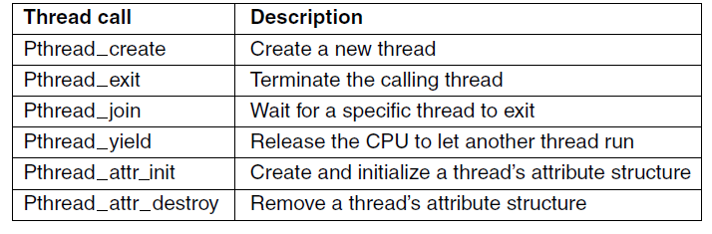
POSIX Threads (1)
Figure 2-14. Some of the Pthreads function calls.
Tanenbaum & Bo,Modern Operating Systems:4th ed., (c) 2013 Prentice-Hall, Inc. All rights reserved.

Slide 21
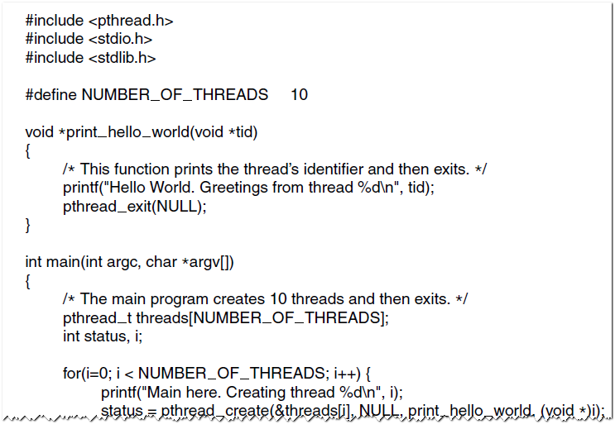
POSIX Threads (2)
Figure 2-15. An example program using threads.
Tanenbaum & Bo,Modern Operating Systems:4th ed., (c) 2013 Prentice-Hall, Inc. All rights reserved.

Slide 22
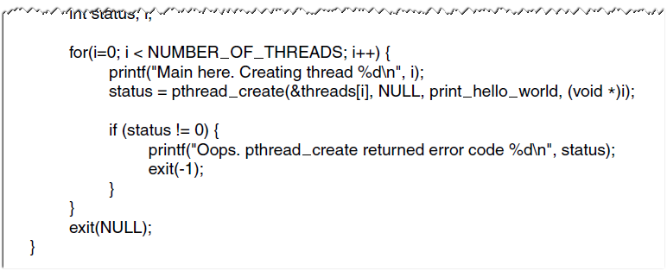
POSIX Threads (3)
Figure 2-15. An example program using threads.
Tanenbaum & Bo,Modern Operating Systems:4th ed., (c) 2013 Prentice-Hall, Inc. All rights reserved.

Slide 23
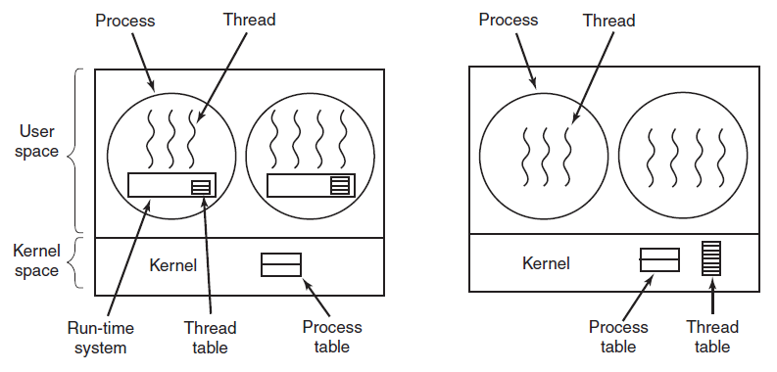
Implementing Threads in User Space
(a)
(b)
Figure 2-16. (a) A user-level threads package.
(b) A threads package managed by the kernel.
Tanenbaum & Bo,Modern Operating Systems:4th ed., (c) 2013 Prentice-Hall, Inc. All rights reserved.

Slide 24
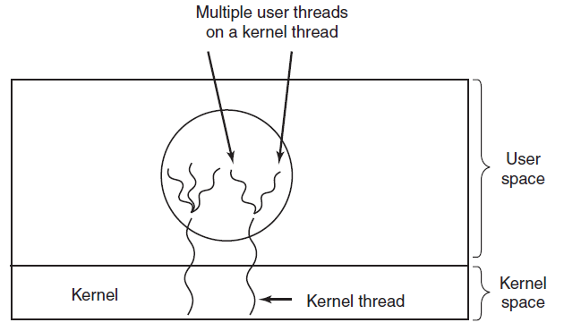
Hybrid Implementations
Figure 2-17. Multiplexing user-level threads
onto kernel-level threads.
Tanenbaum & Bo,Modern Operating Systems:4th ed., (c) 2013 Prentice-Hall, Inc. All rights reserved.

Slide 25
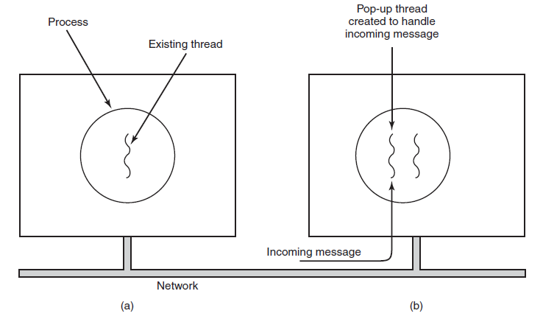
Pop-Up Threads
Figure 2-18. Creation of a new thread when a message arrives. (a) Before the message arrives. (b) After the message arrives.
Tanenbaum & Bo,Modern Operating Systems:4th ed., (c) 2013 Prentice-Hall, Inc. All rights reserved.

Slide 26
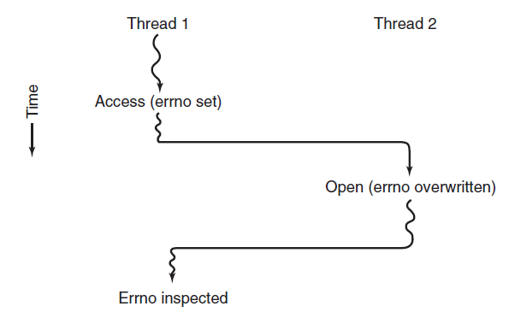
Making Single-Threaded Code Multithreaded (1)
Figure 2-19. Conflicts between threads over the
use of a global variable.
Tanenbaum & Bo,Modern Operating Systems:4th ed., (c) 2013 Prentice-Hall, Inc. All rights reserved.

Slide 27
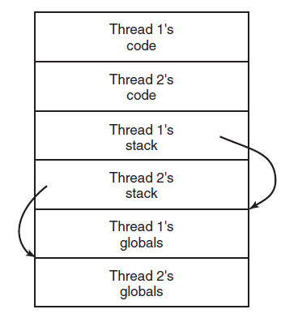
Making Single-Threaded Code Multithreaded (2)
Figure 2-20. Threads can have private global variables.
Tanenbaum & Bo,Modern Operating Systems:4th ed., (c) 2013 Prentice-Hall, Inc. All rights reserved.

Slide 28
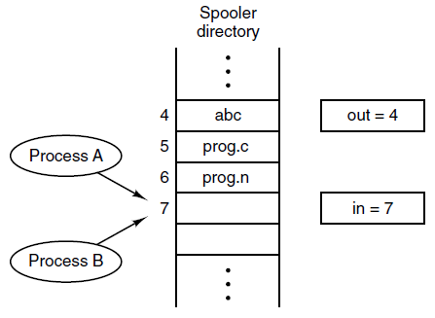
Race Conditions
Figure 2-21. Two processes want to access
shared memory at the same time.
Tanenbaum & Bo,Modern Operating Systems:4th ed., (c) 2013 Prentice-Hall, Inc. All rights reserved.

Slide 29
Critical Regions (1)
Requirements to avoid race conditions:
No two processes may be simultaneously inside their critical regions.
No assumptions may be made about speeds or the number of CPUs.
No process running outside its critical region may block other processes.
No process should have to wait forever to enter its critical region.
Tanenbaum & Bo,Modern Operating Systems:4th ed., (c) 2013 Prentice-Hall, Inc. All rights reserved.

Slide 30
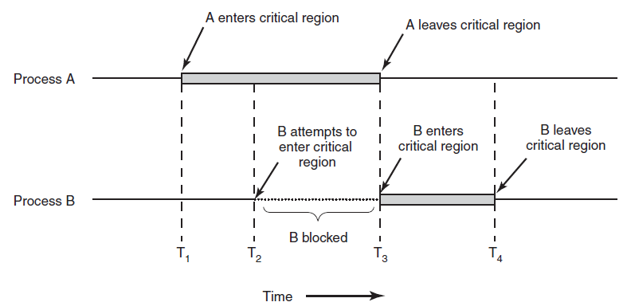
Critical Regions (2)
Figure 2-22. Mutual exclusion using critical regions.
Tanenbaum & Bo,Modern Operating Systems:4th ed., (c) 2013 Prentice-Hall, Inc. All rights reserved.

Slide 31
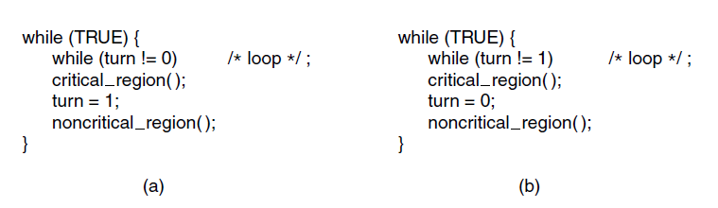
Mutual Exclusion with Busy Waiting:
Strict Alternation
Figure 2-23. A proposed solution to the critical region problem. (a) Process 0. (b) Process 1. In both cases, be sure to note the semicolons terminating the while statements.
Tanenbaum & Bo,Modern Operating Systems:4th ed., (c) 2013 Prentice-Hall, Inc. All rights reserved.

Slide 32
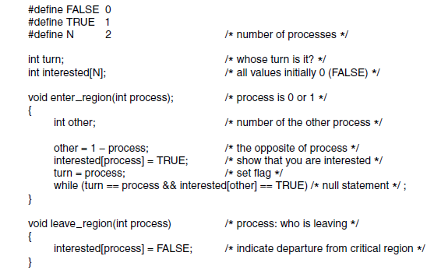
Mutual Exclusion with Busy Waiting:
Peterson’s Solution
Figure 2-24. Peterson’s solution for achieving mutual exclusion.
Tanenbaum & Bo,Modern Operating Systems:4th ed., (c) 2013 Prentice-Hall, Inc. All rights reserved.

Slide 33
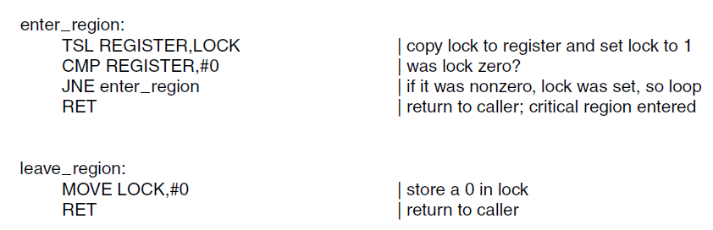
Mutual Exclusion with Busy Waiting:
The TSL Instruction (1)
Figure 2-25. Entering and leaving a critical region
using the TSL instruction.
Tanenbaum & Bo,Modern Operating Systems:4th ed., (c) 2013 Prentice-Hall, Inc. All rights reserved.

Slide 34
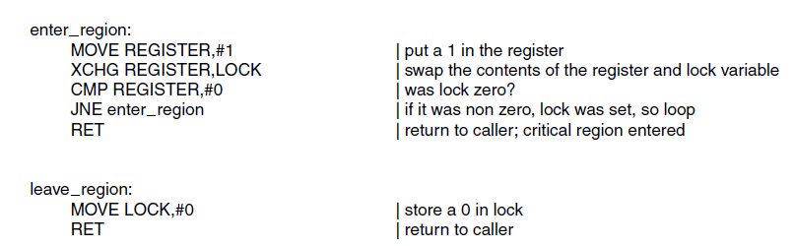
Mutual Exclusion with Busy Waiting:
The TSL Instruction (2)
Figure 2-26. Entering and leaving a critical region
using the XCHG instruction
Tanenbaum & Bo,Modern Operating Systems:4th ed., (c) 2013 Prentice-Hall, Inc. All rights reserved.

Slide 35
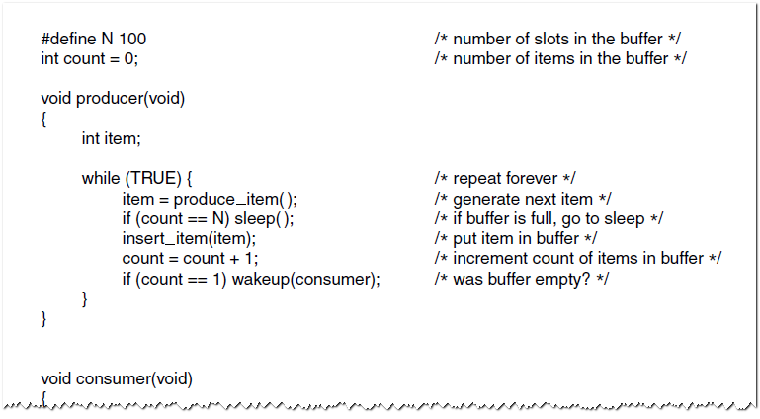
Sleep and Wakeup
The Producer-Consumer Problem (1)
Figure 2-27. The producer-consumer problem
with a fatal race condition.
Tanenbaum & Bo,Modern Operating Systems:4th ed., (c) 2013 Prentice-Hall, Inc. All rights reserved.

Slide 36
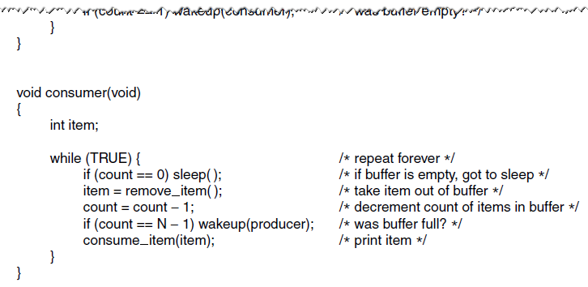
Sleep and Wakeup
The Producer-Consumer Problem (2)
Figure 2-27. The producer-consumer problem
with a fatal race condition.
Tanenbaum & Bo,Modern Operating Systems:4th ed., (c) 2013 Prentice-Hall, Inc. All rights reserved.

Slide 37
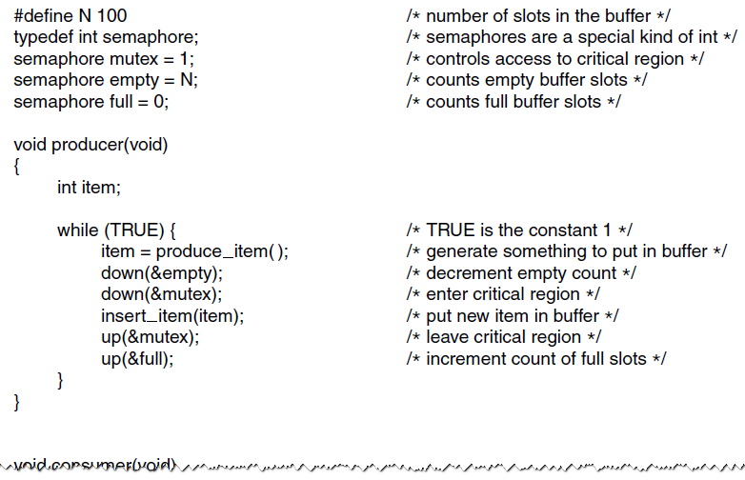
Semaphores (1)
Figure 2-28. The producer-consumer problem
using semaphores.
Tanenbaum & Bo,Modern Operating Systems:4th ed., (c) 2013 Prentice-Hall, Inc. All rights reserved.

Slide 38
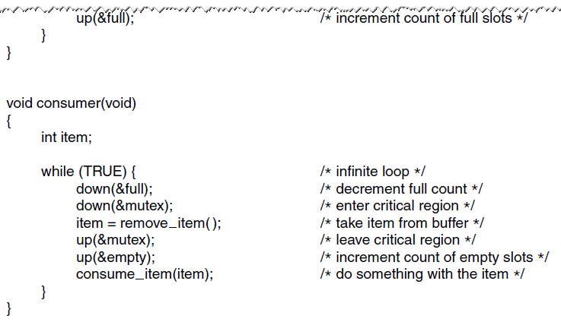
Semaphores (2)
Figure 2-28. The producer-consumer problem
using semaphores.
Tanenbaum & Bo,Modern Operating Systems:4th ed., (c) 2013 Prentice-Hall, Inc. All rights reserved.

Slide 39
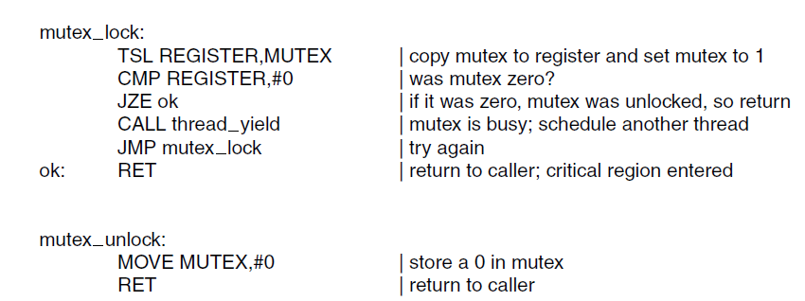
Mutexes
Figure 2-29. Implementation of mutex_lock
and mutex_unlock.
Tanenbaum & Bo,Modern Operating Systems:4th ed., (c) 2013 Prentice-Hall, Inc. All rights reserved.

Slide 40
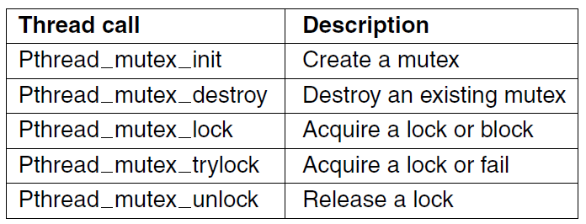
Mutexes in Pthreads (1)
Figure 2-30. Some of the Pthreads calls relating to mutexes.
Tanenbaum & Bo,Modern Operating Systems:4th ed., (c) 2013 Prentice-Hall, Inc. All rights reserved.

Slide 41
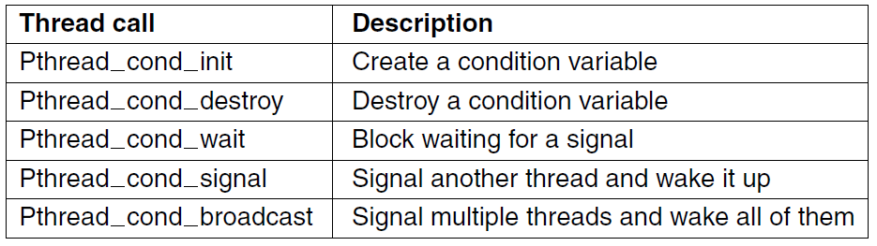
Mutexes in Pthreads (2)
Figure 2-31. Some of the Pthreads calls relating
to condition variables.
Tanenbaum & Bo,Modern Operating Systems:4th ed., (c) 2013 Prentice-Hall, Inc. All rights reserved.

Slide 42
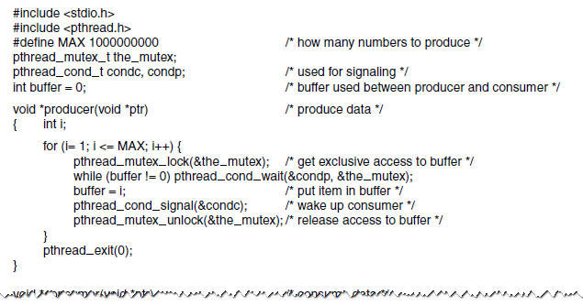
Mutexes in Pthreads (3)
Figure 2-32. Using threads to solve the
producer-consumer problem.
Tanenbaum & Bo,Modern Operating Systems:4th ed., (c) 2013 Prentice-Hall, Inc. All rights reserved.

Slide 43
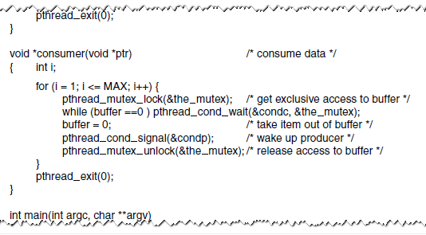
Mutexes in Pthreads (4)
Figure 2-32. Using threads to solve the
producer-consumer problem.
Tanenbaum & Bo,Modern Operating Systems:4th ed., (c) 2013 Prentice-Hall, Inc. All rights reserved.

Slide 44
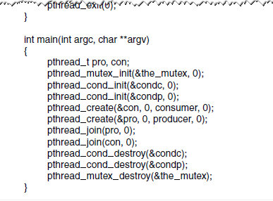
Mutexes in Pthreads (5)
Figure 2-32. Using threads to solve the
producer-consumer problem.
Tanenbaum & Bo,Modern Operating Systems:4th ed., (c) 2013 Prentice-Hall, Inc. All rights reserved.

Slide 45
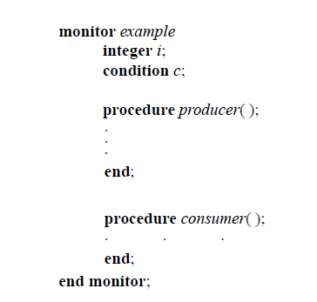
Monitors (1)
Figure 2-33. A monitor.
Tanenbaum & Bo,Modern Operating Systems:4th ed., (c) 2013 Prentice-Hall, Inc. All rights reserved.

Slide 46
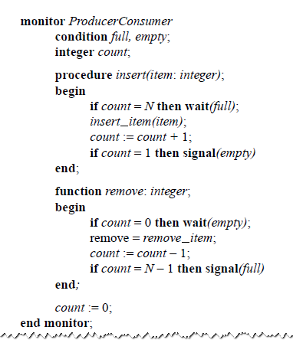
Monitors (2)
Figure 2-34. An outline of the producer-consumer problem with monitors. Only one monitor procedure at a time is active. The buffer has N slots.
Tanenbaum & Bo,Modern Operating Systems:4th ed., (c) 2013 Prentice-Hall, Inc. All rights reserved.

Slide 47
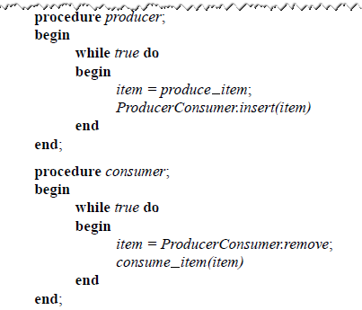
Monitors (3)
Figure 2-34. An outline of the producer-consumer problem with monitors. Only one monitor procedure at a time is active. The buffer has N slots.
Tanenbaum & Bo,Modern Operating Systems:4th ed., (c) 2013 Prentice-Hall, Inc. All rights reserved.

Slide 48
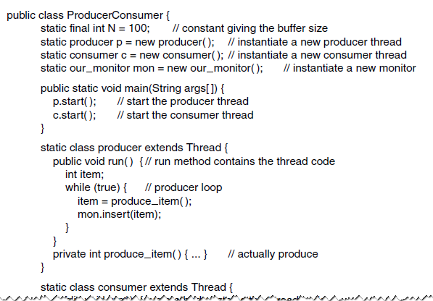
Monitors (4)
Figure 2-35. A solution to the producer-consumer
problem in Java.
Tanenbaum & Bo,Modern Operating Systems:4th ed., (c) 2013 Prentice-Hall, Inc. All rights reserved.

Slide 49
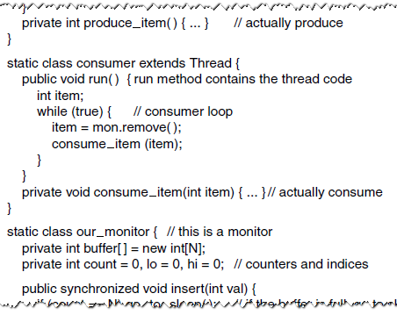
Monitors (5)
Figure 2-35. A solution to the producer-consumer
problem in Java.
Tanenbaum & Bo,Modern Operating Systems:4th ed., (c) 2013 Prentice-Hall, Inc. All rights reserved.

Slide 50
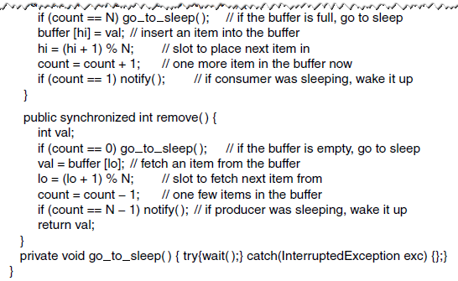
Monitors (6)
Figure 2-35. A solution to the producer-consumer
problem in Java.
Tanenbaum & Bo,Modern Operating Systems:4th ed., (c) 2013 Prentice-Hall, Inc. All rights reserved.

Slide 51
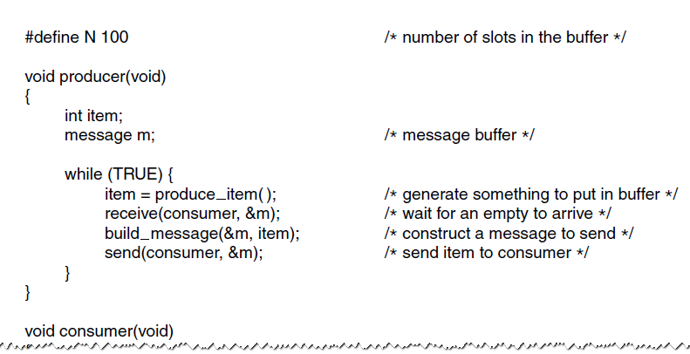
The Producer-Consumer Problem with Message Passing (1)
Figure 2-36. The producer-consumer
problem with N messages.
Tanenbaum & Bo,Modern Operating Systems:4th ed., (c) 2013 Prentice-Hall, Inc. All rights reserved.

Slide 52
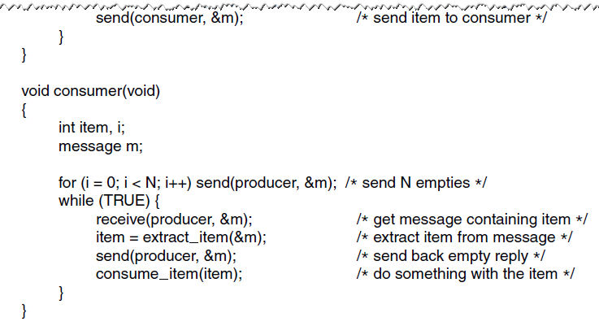
The Producer-Consumer Problem with Message Passing (2)
Figure 2-36. The producer-consumer
problem with N messages.
Tanenbaum & Bo,Modern Operating Systems:4th ed., (c) 2013 Prentice-Hall, Inc. All rights reserved.

Slide 53
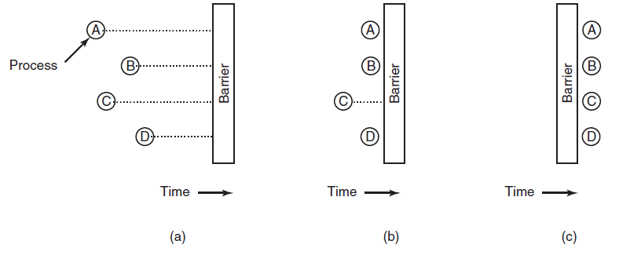
Barriers
Figure 2-37. Use of a barrier. (a) Processes approaching a barrier. (b) All processes but one blocked at the barrier. (c) When the last process arrives at the barrier, all of them are let through.
Tanenbaum & Bo,Modern Operating Systems:4th ed., (c) 2013 Prentice-Hall, Inc. All rights reserved.

Slide 54
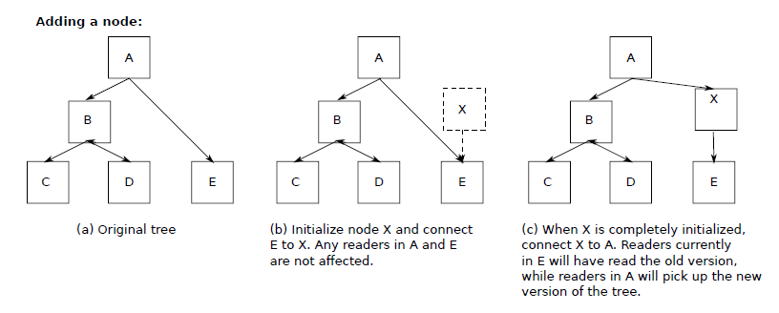
Avoiding Locks: Read-Copy-Update (1)
Figure 2-38. Read-Copy-Update: inserting a node in the tree and then removing a branch—all without locks
Tanenbaum & Bo,Modern Operating Systems:4th ed., (c) 2013 Prentice-Hall, Inc. All rights reserved.

Slide 55
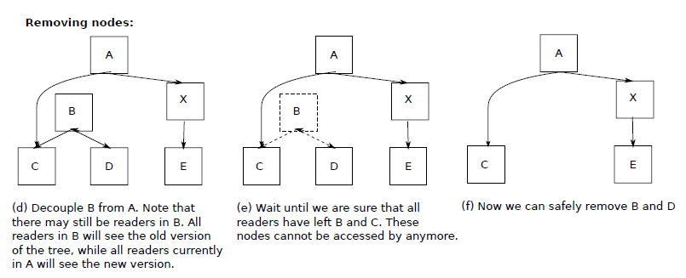
Avoiding Locks: Read-Copy-Update (2)
Figure 2-38. Read-Copy-Update: inserting a node in the tree and then removing a branch—all without locks
Tanenbaum & Bo,Modern Operating Systems:4th ed., (c) 2013 Prentice-Hall, Inc. All rights reserved.

Slide 56

Introduction to Scheduling
Process Behavior
Figure 2-39. Bursts of CPU usage alternate with periods of waiting for I/O. (a) A CPU-bound process. (b) An I/O-bound process.
Tanenbaum & Bo,Modern Operating Systems:4th ed., (c) 2013 Prentice-Hall, Inc. All rights reserved.

Slide 57
Categories of Scheduling Algorithms
Batch.
Interactive.
Real time.
Tanenbaum & Bo,Modern Operating Systems:4th ed., (c) 2013 Prentice-Hall, Inc. All rights reserved.

Slide 58

Scheduling Algorithm Goals
Figure 2-40. Some goals of the scheduling algorithm under different circumstances.
Tanenbaum & Bo,Modern Operating Systems:4th ed., (c) 2013 Prentice-Hall, Inc. All rights reserved.

Slide 59
Scheduling in Batch Systems
First-Come First-Served
Shortest Job First
Shortest Remaining Time Next
Tanenbaum & Bo,Modern Operating Systems:4th ed., (c) 2013 Prentice-Hall, Inc. All rights reserved.

Slide 60

Shortest Job First
Figure 2-41. An example of shortest job first scheduling.
(a) Running four jobs in the original order.
(b) Running them in shortest job first order.
Tanenbaum & Bo,Modern Operating Systems:4th ed., (c) 2013 Prentice-Hall, Inc. All rights reserved.

Slide 61
Scheduling in Interactive Systems
Round-Robin Scheduling
Priority Scheduling
Multiple Queues
Shortest Process Next
Guaranteed Scheduling
Lottery Scheduling
Fair-Share Scheduling
Tanenbaum & Bo,Modern Operating Systems:4th ed., (c) 2013 Prentice-Hall, Inc. All rights reserved.

Slide 62


Round-Robin Scheduling
Figure 2-42. Round-robin scheduling. (a) The list of
runnable processes. (b) The list of runnable
processes after B uses up its quantum.
Tanenbaum & Bo,Modern Operating Systems:4th ed., (c) 2013 Prentice-Hall, Inc. All rights reserved.

Slide 63

Priority Scheduling
Figure 2-43. A scheduling algorithm with four priority classes.
Tanenbaum & Bo,Modern Operating Systems:4th ed., (c) 2013 Prentice-Hall, Inc. All rights reserved.

Slide 64

Scheduling in Real-Time Systems
Time plays an essential role
Categories
  Hard real time
  Soft real time
  Periodic or aperiodic
Schedulable satisfies
Tanenbaum & Bo,Modern Operating Systems:4th ed., (c) 2013 Prentice-Hall, Inc. All rights reserved.

Slide 65

Thread Scheduling (1)
Figure 2-44. (a) Possible scheduling of user-level threads with a 50-msec process quantum and threads that run 5 msec per CPU burst.
Tanenbaum & Bo,Modern Operating Systems:4th ed., (c) 2013 Prentice-Hall, Inc. All rights reserved.

Slide 66

Thread Scheduling (2)
Figure 2-44. (b) Possible scheduling of kernel-level threads
with the same characteristics as (a).
Tanenbaum & Bo,Modern Operating Systems:4th ed., (c) 2013 Prentice-Hall, Inc. All rights reserved.

Slide 67

The Dining Philosophers Problem (1)
Figure 2-45. Lunch time in the Philosophy Department.
Tanenbaum & Bo,Modern Operating Systems:4th ed., (c) 2013 Prentice-Hall, Inc. All rights reserved.

Slide 68

The Dining Philosophers Problem (2)
Figure 2-46. A nonsolution to the dining philosophers problem.
Tanenbaum & Bo,Modern Operating Systems:4th ed., (c) 2013 Prentice-Hall, Inc. All rights reserved.

Slide 69

The Dining Philosophers Problem (3)
Figure 2-47. A solution to the dining philosophers problem.
Tanenbaum & Bo,Modern Operating Systems:4th ed., (c) 2013 Prentice-Hall, Inc. All rights reserved.

Slide 70

The Dining Philosophers Problem (4)
Figure 2-47. A solution to the dining philosophers problem.
Tanenbaum & Bo,Modern Operating Systems:4th ed., (c) 2013 Prentice-Hall, Inc. All rights reserved.

Slide 71

The Dining Philosophers Problem (5)
Figure 2-47. A solution to the dining philosophers problem.
Tanenbaum & Bo,Modern Operating Systems:4th ed., (c) 2013 Prentice-Hall, Inc. All rights reserved.

Slide 72

The Readers and Writers Problem (1)
Figure 2-48. A solution to the readers and writers problem.
Tanenbaum & Bo,Modern Operating Systems:4th ed., (c) 2013 Prentice-Hall, Inc. All rights reserved.

Slide 73

The Readers and Writers Problem (2)
Figure 2-48. A solution to the readers and writers problem.
Tanenbaum & Bo,Modern Operating Systems:4th ed., (c) 2013 Prentice-Hall, Inc. All rights reserved.

Slide 74
End
Chapter 2
Tanenbaum & Bo,Modern Operating Systems:4th ed., (c) 2013 Prentice-Hall, Inc. All rights reserved.

